Slide 1
Introducing Wicked Writers: Be the Change 2024

Slide 2
What is Wicked Writers: Be the Change?
The National Literacy Trust, in partnership with the stage musical Wicked, have created a writing competition all about changing our world – for the better. This year’s theme is the environment.
The competition opens on 29 January 2024 and entries must be submitted by 11 March 2024 for pupils to be in with a chance of winning, you can find more information here.
The competition concludes with an exciting judging panel including author MG Leonard, incredible prizes including tickets to see Wicked at the Apollo Victoria Theatre in London, a writing workshop with MG Leonard, the chance to be published in an Anthology and a delivery of amazing books to your school.

Slide 3
2024 Theme: The Environment
This year, you will be writing persuasively and talking about the change you’d like to see!
This means writing about an environmental issue that you’re passionate about to motivate your audience to make a change.
Notes:
Judging and prizes
We have a fantastic judging panel, including author MG Leonard, who will be deciding the winners in each of two age groups categories, age 9 to 11 (UKS2, P6 to P7) and age 12 to 14 (KS3, S1 to S3). Prizes will include:
tickets and funding to take your class to see Wicked at the Apollo Victoria Theatre in London
The chance to have your work published in an Anthology
a writing workshop with MG Leonard
plus lots of books for your students.

Slide 4
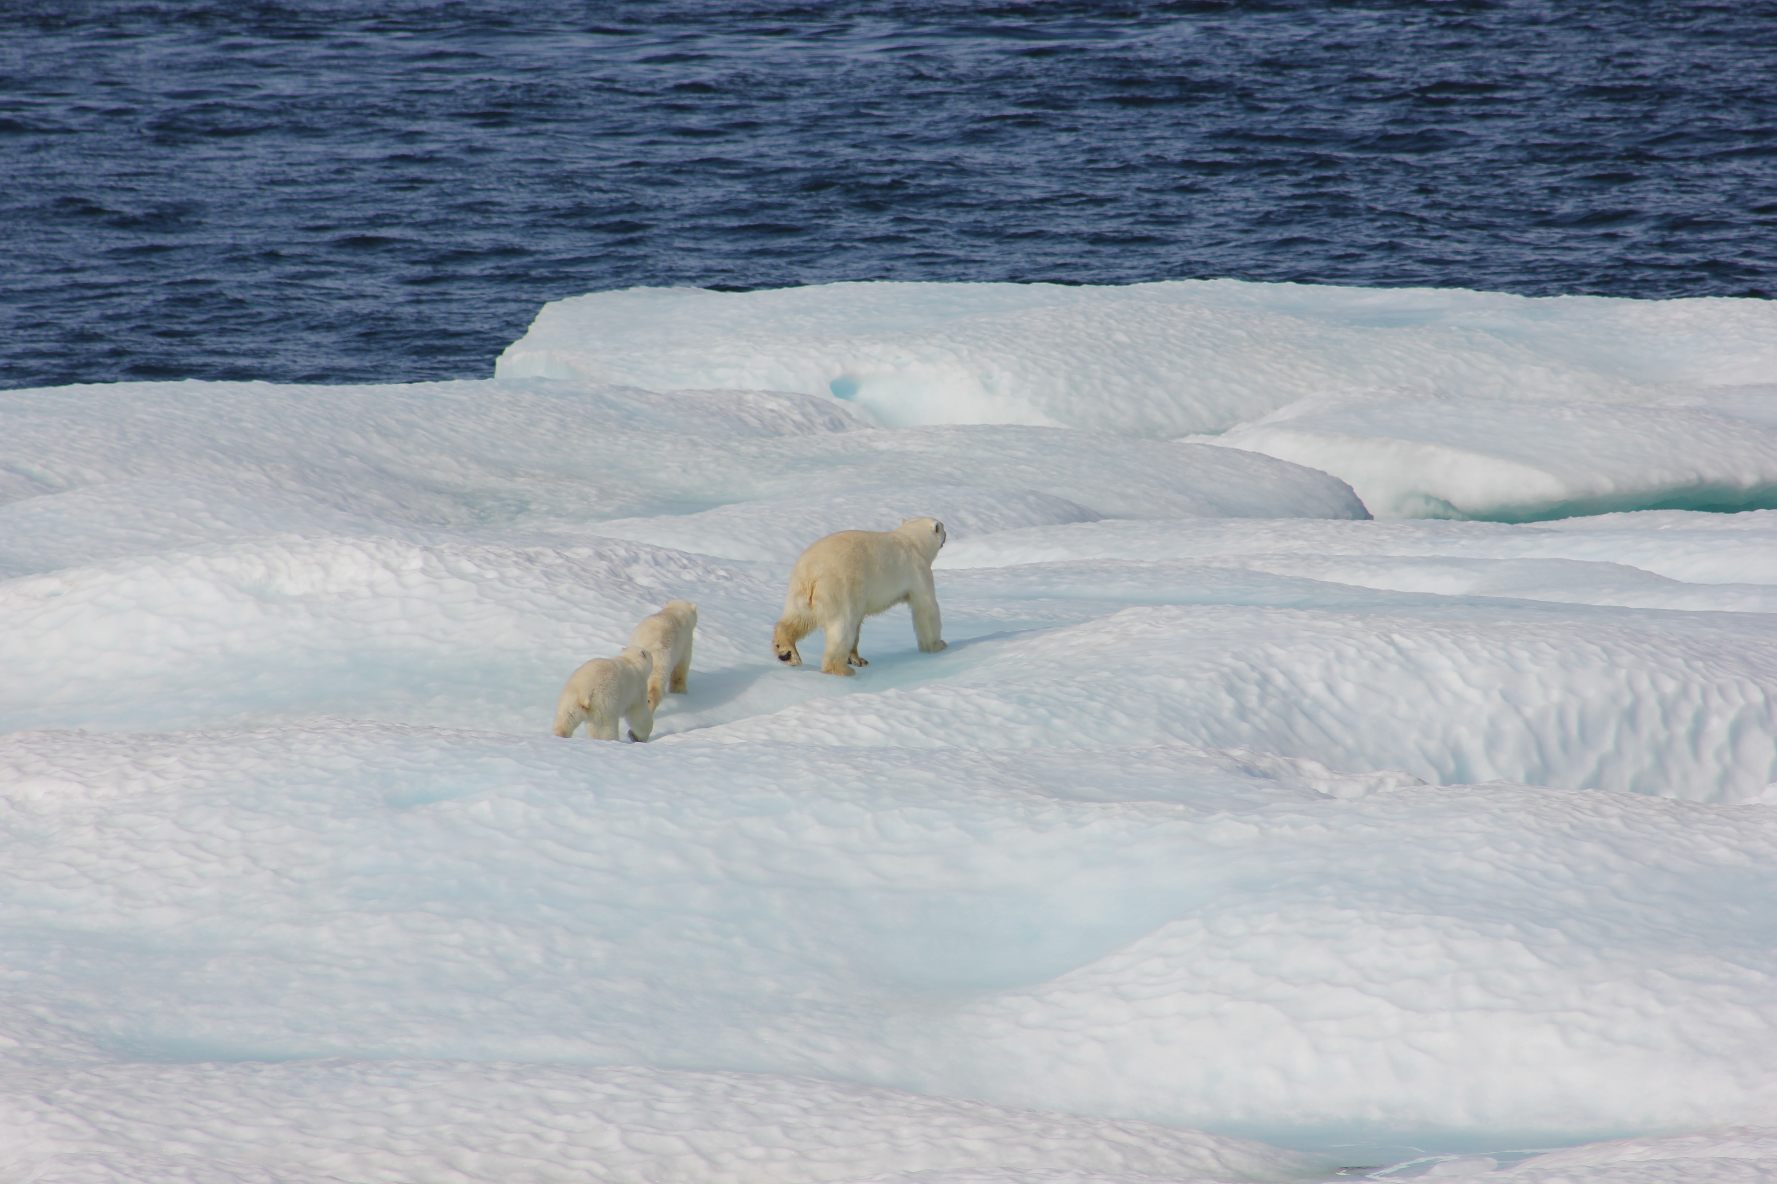
2024 Theme: The Environment
You could be talking about reducing plastic waste, protecting endangered species, access to clean water, or the effects of the climate crisis on particular groups of people. Or many other things!
The trick is to write about something you have strong feelings towards as this will show in your writing.

Slide 5
Examples of Ideas for Change
School ideas
Does your school have a recycling policy?
Does your school use energy carefully?
Do you agree with what your school kitchen does with unsold food and drink?
Local ideas
Does your community value recycling?
Does your community prioritise public transport?
What does the community do to help wildlife?
Worldwide ideas
Do people around the world have access to clean water?
Will the climate crisis affect everyone equally?
Are the oceans being looked after?

Slide 6
Introducing Wicked
Change for the better is a key theme in Wicked and the subject of the song For Good, which sees the Wicked Witch of the West and Glinda The Good singing about how their friendship has changed their lives
‘Because I knew you, I have been changed for good’.
Watch the video from Wicked.
.

Slide 7
Lessons
Throughout these sessions, you will have the opportunity to:
Lesson one
Build your confidence when using persuasive language and to develop key vocabulary skills
Read and listen to great examples of persuasive writing, which have inspired positive change
Analyse in depth an example of persuasive writing.
Lesson two
Plan a piece of persuasive writing
Write persuasively and Be the Change for the environment!

Slide 8
Lesson One
Exploring and Analysing Persuasive Writing

Slide 9
What is persuasive writing?
Persuasive writing is a form of non-fiction writing that persuades the reader of a belief, an opinion or an idea.
Persuasive writing uses authoritative, emotional, factual and logical arguments.

Slide 10
What are some examples of persuasive writing?
A letter…
to your local MP asking for more bins to tackle the flooding problem
A review…
Of a business that isn’t environmentally responsible
An advert…
Encouraging people to donate to a local wildlife cause
A proposal…
To your school for a new way of dealing with food waste
A speech…
Encouraging people to tackle the climate crisis
Notes:
Think of some other examples.

Slide 11
What is persuasive/emotive language?
Persuasive or emotive language aims to persuade the reader or listener to share the writer or speaker's point of view, using language chosen specifically to create an emotional reaction.
For example: ‘Our experts will tell you a million reasons why it can't or shouldn't be done here, BUT the world needs us to take action NOW.’
Through using exaggeration and urgency, the writer is able to grip the readers’ or listeners’ interest.
Can you think of your own examples in pairs?

Slide 12
Word Bank
Positive/for |  | Negative/against
Commands: Write, do, act, stop, discover |  | Commands: Write, do, act, stop, discover
Advantage | Certain | Abolish | Aggravate
Accurate | Confident | Appalled | Careless
Convenient | Definitely | Damaging | Eliminate
Effective | Guaranteed | Harmful | Inconsiderate
Implore | Proven | Insensitive | Offend
Safe | Strongly suggest | Provoke | Severe
Trustworthy | Urge | Unreliable | Unstable

Slide 13
Would you rather…?
Be able to read minds or talk to animals?
Discover humans on another planet or extend life for humans for 100 years?
Be a successful artist or a successful business owner
Have adverts not exist or never have to queue again?
Have a successful podcast or a successful YouTube channel?
Visit every country in the world or be able to play musical instruments?
Use the word bank provided in the resource pack to enhance your answers.
Notes:
You can find more discussion points on the next three slides.

Slide 14
Discuss the statement
Everyone around the world should have access to clean water.
Endangered species are more important than large companies making a profit
Taking care of the environment is entirely in the hands of adults.
We don’t need to worry about problems like flooding unless it’s affecting our own neighbourhood.
The climate crisis will affect everyone equally.

Slide 15
Heads or tails
Heads | Tails
Eating insects would help reduce meat consumption | Literacy is more important than maths.
We should all buy fewer clothes | Xbox is better than PlayStation
All public transport should be free | Pupils under the age of 18 should not be allowed on the internet
The UK should invest in recycling more. | Pizza is better than chocolate
We should all be vegetarians | Pupils should not wear school uniforms

Slide 16
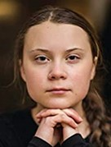
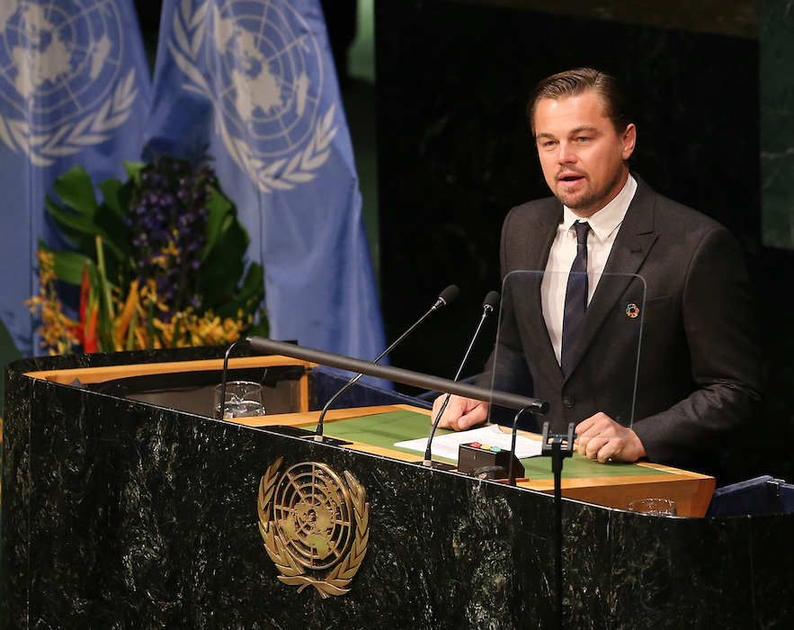
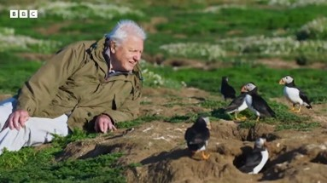
Main Activity
Leonardo DiCaprio
Climate Summit Speech, 2014
Greta Thunberg
UN Climate Action Summit, 2019
Sir David Attenborough
COP26 Climate Summit, 2021
Notes:
Explore the speeches together as a class. The transcripts are attached in the resource pack.

Slide 17
Group activity
What positive environmental change is the speaker calling for?
What is the purpose of their speech?
Who is their intended audience?
Why is this change important to the speaker?
How does the reader/listener know the topic is important?
What language has the speaker used to elicit emotion in the listener/reader?
Do you notice anything about the format of the speech?
How do you feel after reading/listening to this persuasive piece?

Slide 18
Key features found in persuasive writing:
Modal verbs
Facts
3. Opinions
4. Arguments
5. Conclusion
6. Emotive language
7. Literacy techniques such as alliteration, metaphors, and repetition

Slide 19
Plenary
Choose a persuasive writing feature that you have focused on today, for example emotive language or rhetoric.
Write a persuasive sentence for or against the statement that uses your chosen language feature.
Statement: ‘Companies’ profits are more important than endangered species.’

